Slide 1
Contextual Conversational Engine
RASA CORE

Slide 2
List of contents:
RASA CORE ARCHITECTURE :
TRAINING PROCESS
TRAINING DATA
DOMAIN
LOAD AGENT
POLICY
FEATURIZATION
PARAMETERS
LOAD DATA
TRAINING
PERSIST
PREDICTION PROCESS
LOAD MODEL
INTERPRETER
CREATE OR UPDATE TRACKER
FEATURES
POLICY ENSEMBLE
UPDATE TRACKER
EXECUTE ACTION

Slide 3
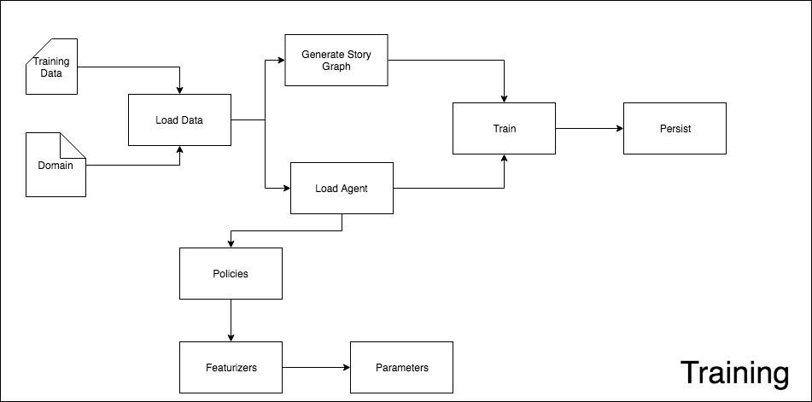

Slide 4
TRAINING PROCESS
TRAINING DATA
This is essentially all the stories where you typically define what is a normal conversation for your process, you define this in a particular rasa core format

Slide 5
TRAINING PROCESS
TRAINING DATA
A training example for the Rasa Core dialogue system is called a story.
A story starts with name preceded by two hashes followed by a name, it can be very useful for debugging to give them descriptive names.
Messages sent by the user are shown as lines starting with * in the format intent{"entity1": "value", "entity2": "value"}.
Actions executed by the bot are shown as lines starting with - and contain the name of the action.
Events returned by an action are on lines immediately after that action.

Slide 6
Example story

Slide 7
DOMAIN
Domain basically determines what your chatbot should understand, what the chatbot can do and what kind of information is necessary for your chatbot’s context so it understands the user better.
It specifies the intents, entities, slots, and actions your bot should know about.
it can also include templates for the things your bot can say.

Slide 8
AGENT
I wanted to start with first loading the agent here before explaining loading the data because the Agent(or the bot) is first loaded with some parameters that determines how the training data will be converted into features for training the agent.
The agent allows you to train a model, load, and use it. It is a simple API that lets you access most of Rasa Core’s functionality.

Slide 9
POLICY
This is the core model architecture of the bot, A policy is what will define what is going to be the next action.
There are different policies to choose from, and you can include multiple policies in a single rasa_core.agent.Agent. At every turn, the policy which predicts the next action with the highest confidence will be used.
As Rasa core is open-source, you can indeed create your own policy.
The rasa_core.policies.Policy class decides which action to take at every step in the conversation.
You will have more information here — https://rasa.com/docs/core/policies/

Slide 10
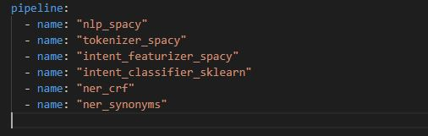
Configuring Policies using a configuration file
If you are using the training script, you must set the policies you would like the Core model to use in a YAML file.

Slide 11
POLICIES
MEMOIZATION POLICY
FALLBACK POLICY
KERAS POLICY
MEMOIZATION POLICY
the core idea for this policy or let’s say algorithm is to copy your training data and remember them by heart and then predict the next action.
Here the predict is binary, if the conversation matches one of the stories in your training data then the next action will have a confidence of 1, if it doesn’t then the confidence is 0.

Slide 12
KERAS POLICY
One of the Machine learning model is a Recurrent Neural Network (LSTM) that takes in a bunch of features to predict the next possible action.
FALLBACK POLICY
This is a straight forward functional logic that takes three parameters NLU threshold, Core threshold, and fallback action. If the NLU threshold is below a given percentage , fallback action will be called.
However if the NLU threshold is okay but the given intent is not present in the domain, it will call the fallback action.
Core threshold is the second fallback where the bot understood the intent very well but is unsure about the action predicted and it is below the Core threshold, then fallback action is called.

Slide 13
FEATURIZATION
In order to apply machine learning algorithms to conversational AI, we need to build up vector representations of conversations.
Each story corresponds to a tracker which consists of the states of the conversation just before each action was taken.
The basic idea for any model to work specially a neural network, is that the network needs to be fed with a bunch of features that determines the next action in the conversation, these features are generally vector representation of the conversation.
so Keras policy for example — each state of the conversation will contain a bunch of features such as intents, entities, slots and previous actions.

Slide 14
The total number of states for which every feature is determined is then fed to the network that predicts a label(one of your actions in the list).
Documentation of featurization: https://rasa.com/docs/core/api/featurizer/

Slide 15
PARAMETERS
In order to feed the policies with a bunch of conversation features, there is one hyperparameter plays a really important role that is max_history.
MAX HISTORY
max_history basically provides a value which determines the number of feature set that is needed to be fed to the neural network.
It is also useful for story generation we will talk about below.
In order for the network to provide an output, we will need to figure how much in the past of the conversation does the policy needs to look back in order to determine what to do next in a conversation.

Slide 16
By default Max History is set at 5, so let’s say for Memoization policy which is using a max_hisory of 5, will look back 5 steps in your tracker to determine if the next step matches with any stories in your training data. Similarly, for Keras policy, max history also increases the total number of features that is driving the conversation.

Slide 17
LOAD DATA
Once you have your Domain and your training data in Rasa Core format, it is time to load the data, there are a few more parameters which are important in this case.
Augmentation Factor
This parameters upon loading the stories, will start randomly glueing stories together to create longer stories. If you want that there is no augmentation of your training data , you can skip this by setting it to 0 upon training. By default , it is 20.

Slide 18
TRAINING
Policies works in an ensemble, meaning you can pass more than one policy to the Agent-by default Memoization and Keras policies are fed for the training process, each of them trains separately, however they are used together in an ensemble to predict the next action and only one wins the battle. More on that later

Slide 19
PERSIST
Persist — Once you have trained your model, it is then persisted to a file system or a cloud storage of your choice

Slide 20
PREDICTING PROCESS
LOAD MODEL
Let’s start first by loading the model in memory before serving using a Server and exposing an endpoint related to a particular channel.

Slide 21
INTERPRETER
the assumption is that we have a running interpreter that is able to read the raw text coming in from user and throw out the intention of the user along with some meaning entities, these entities which we are saving as slots that will drive the conversation.

Slide 22
CREATE OR UPDATE TRACKER
If this is the first message of the conversation, rasa core will create a tracker object with the key — sender_id which is the incoming identifier of the user, make sure this id is unique to one user otherwise the prediction might not be coherent for a particular human being.
Tracker object usually contains what is found out by the interpreter

Slide 23
FEATURES
Once you have the tracker object, you will now need to featurize what is present in the tracker based on the policy we have set upon training and the necessary parameters such as the max_history, once these features are generated, it will given to the policy ensemble which will determine the final outcome.

Slide 24
POLICY ENSEMBLE
Since, we have trained different policies, when it comes to predicting the next action, each of these policies will provide a score for the particular action. Then there is a max taken from all scores given by every policy and whichever wins, will be the next action.

Slide 25
UPDATE TRACKER
Once you have the action predicted, you will need to update the tracker for the next turn
EXECUTE ACTION
Now you will be finally executing your action, be it an API call or a message sent back to the user

